Slide 1
Brian Pilecki, Ph.D. Gregory Wells, Ph.D. Nathan Gates, MA, LCPC
An ACT-Based Approach to Psychedelic Harm Reduction and Integration Therapy

Slide 2
Disclosures
Relevant financial disclosures
Gregory Wells
None
Nathan Gates
None
Brian Pilecki
None
Relevant nonfinancial relationships
None to declare

Slide 3
Outline of Workshop
Part 1: Introduction to psychedelic assisted therapy
Part 2: ACT-based harm reduction therapy
Part 3: ACT-based integration therapy
Part 4: Break-out rooms, Questions and discussion

Slide 4
Part 1: Introduction to Psychedelic Assisted Therapy
CONTEXT

Slide 5
HAVE YOU USED:
Check all that apply Psychedelic (LSD, Psilocybin, mescaline, ayahuasca) 1) 1-7 times
2) 8 or more times MDMA (ecstacy) 3) 1-7 times
4) 8 or more times 5) NONE
Notes:
So, to satisfy my curiosity and to learn a bit of context about who is here, I'd love for you to answer the anonymous poll regarding your experiences with psychedelics:

Slide 6
What is Psychedelic Experiencing?
For the purposes of this talk, I am referring to a Manner of Experiencing, commonly evoked by the ingestion of certain substances
Altered state of consciousness: changes to emotions, thoughts, perception
Distorted sense of time
Change in sense of self
Ego loss
Connectedness
Sacredness
Ineffable
Noetic quality

Slide 7
Psychedelics are Weird
Notes:
OK. So, I want to start with the vital recognition that psychedelics are weird. This is, obviously, neither a clinical nor a scientific term, but I would wager it is one that would garner near universal agreement among psychedelic users. Psychedelic drugs evoke massive disruptions to the way that one normally perceives the world, themselves, and at times the very nature of reality itself.

Slide 8
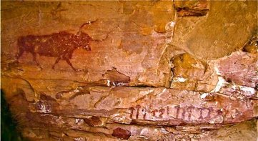
Prehistory
Selva Pascuala, Spain
Cave Painting 6000 years ago depict what appear to be Psilocybe Hispanica
Researchers believe this represents the earliest evidence of ritualistic psychedelic use in Europe
Bradshaw Rock Art
NW Australia
Very, very old (17,000-25,000 years)
Shared features with other Shamanic rock art in north Africa, with aspects of trancelike, visionary states.

Slide 9
Soma/Amrita
“We drank soma, we became immortal, we came to the light, we found gods.”
Rig Veda, Hindu scripture
Soma and Amrita are both consumable drinks mentioned in Hindu and Buddhist texts. Arguments can be made that both were originally hallucinogenic

Slide 10
CHAVIN Peru, 2000-1000 BCE
Chavin is the site of a pre-Incan temple in what is now Peru.
There is considerable evidence that it was the site for long-standing, ceremonial rites involving the ingestion of mescaline derived from the locally native San Pedro Cactus

Slide 11
Eleusinian Mysteries Athens, 700 BCE
Kykeon
Featured prominently in the ritual ceremonies of the Eleusinian Mysteries
Origins of the drink hotly debated
A prominent theory is that it contains the Ergot fungus, known to grow on Barley
Ergot is hallucinogenic and is used in the synthesis of LSD
Persephone and Demeter
The mysteries involve the ceremonial reenactment of the story of Persephone and Demeter.
Demeter was the goddess of the harvest and of the cycles of life and death
The Mysteries took place in three acts, the descent, the search, and the ascent

Slide 12
Maria Sabina and Shamanism
Born in southern Mexico in 1895
Part of a shamanistic tradition focused on healing the sick
Introduced westerners to the psilocybin healing ceremonies, known as Veladas.
Spoke poetry, did chants and tonal songs during healing ceremonies.

Slide 13
Modern Religious Use
NATIVE AMERICAN CHURCH
SANTO DAIME

Slide 14
The west discovers psychedelics
Notes:
Nov 16 1938
April 16 1943
April 19 1943
Wasson June 10 1957

Slide 15
Cultural Elite
Notes:
Mescaline 1953

Slide 16
Psychiatry, Psychology and Self-Help
Willam James
Humphrey Osmond
Bill W.

Slide 17
Scientific Research​ During Second Wave
1950-1965: 40,000 patients treated with LSD therapy (alcoholism, neurosis, personality disorders, schizophrenia etc).​
1000+ scientific papers and six international conferences​
“Good Friday” Experiment​
Double-blind placebo-controlled administration of psilocybin mushrooms to divinity students during Good Friday mass ​
Results: active group had stronger religious experiences​
Concord Prison Experiment​
Psilocybin mushrooms and psychotherapy offered to inmates before release​
Results: inconclusive due to methodological issues

Slide 18
Early Scientific Models of Psychedelic Action Emerging from research during the ‘50’s, ‘60’s & ‘70”s
Psychotomimetic
Psycholytic
Psychedelic
Proposed that the experience of the psychedelic user mimicked that of a person struggling with “madness”
Psychedelic medicines could be a useful tool for exploring the experience of madness and developing new treatments.
Did not stand up to testing
The therapeutic use of psychedelic medicines lay in administration of a relatively small dose of drug that allows a person to retain possession of their faculties.
During the experience, participants were thought to have access to “repressed” or “unconscious” memories and could fruitfully participate in psychodynamic therapy.
The administered dose of psychedelic is high to very high.
The goal of administration is to evoke an extremely strong experience in the user.
The experience itself is thought to be therapeutic, and the purpose of guides or therapists is one of preparation and integration
Is the root of most currently tested “psychedelic-assisted psychotherapy” treatment trials.

Slide 19
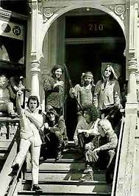
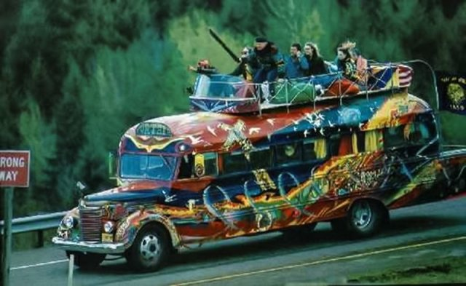
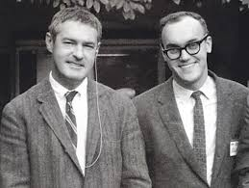
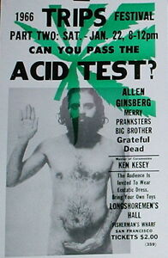
COUNTER CULTURE

Slide 20
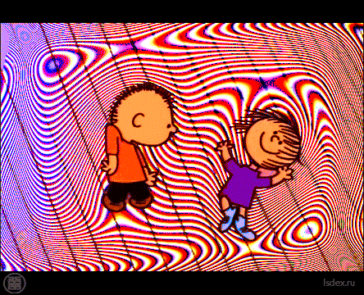

Slide 21
The War on Drugs
"The Nixon campaign in 1968, and the Nixon White House after that, had two enemies: the antiwar left and black people. You understand what I'm saying? We knew we couldn't make it illegal to be either against the war or black, but by getting the public to associate the hippies with marijuana and blacks with heroin. And then criminalizing both heavily, we could disrupt those communities. We could arrest their leaders. raid their homes, break up their meetings, and vilify them night after night on the evening news. Did we know we were lying about the drugs? Of course we did.“
former Nixon domestic policy chief John Ehrlichman

Slide 22
Controlled Substances Act (1970)
As shown in the previous slide, the CSA is a tool of oppression
We must be wary of the implications of merely lifting restrictions of our favorite substances while leaving the oppressive structure of the CSA in place

Slide 23
Isn't the DEA classification scheme based on Scientific Data?
NOPE

Slide 24
The Psychedelic Renaissance
A thawing of FDA and DEA restrictions on new research began in the late 1990’s.
Slowly academic research picked up gaining significant steam in the last 5 years.
Psilocybin and MDMA are currently in phase 3 of the FDA approval process for medical utility. Current estimates for approval (pre-covid) 2021-2023
The Oregon Psilocybin Initiative is on the November ballot, which would lead to the creation of a legal framework for legal psilocybin therapy in that state.
Nationwide there is a growing movement to decriminalize psilocybin containing mushrooms

Slide 25
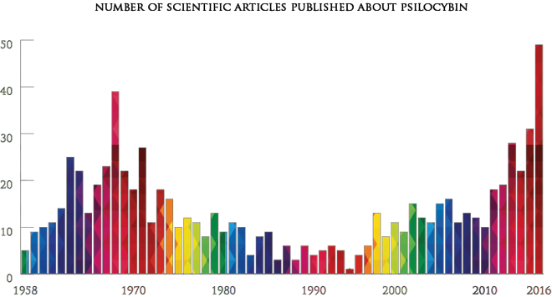
Psilocybin Research Articles: 1958-2016
*Beckley Foundation, 2016

Slide 26
Historical Contexts
CEREMONIAL
COMMUNAL
CELEBRATORY
RITUALISTIC
SHAMANISTIC
HEALING
THERAPEUTIC
INDIVIDUAL DEVELOPMENT
SPIRITUAL
ARTS AND LITERATURE
AESTHETIC
SCIENTIFIC
REMEDIATING PATHOLOGY (MENTAL ILLNESS)
MILITARY AND ESPIONAGE
ILLEGAL/TABOO

Slide 27
Functional Contextualism
The "a-ontological" stance of FC avoids infinite strange rabbit holes- what is "real" is not the subject of investigation
"Set and Setting": a great deal of the experience will be contingent upon the contextual factors at play- which can be incredibly varied
Asks us to be clear about what we are looking for in terms of "workability"
Hold all conceptualizations lightly

Slide 28
Essential Acknowledgments
Psychedelic experiencing is clearly deeply powerful and mysterious
We must decrease stigma and end oppressive drug laws
Any beneficial practices regarding psychedelic medicine must be accessible to all in need
Transformative experiences may arise in many contexts, including "recreational" or "celebratory"
We must remain open to myraid wisdom traditions

Slide 29
Part 2: ACT-Based Harm Reduction Therapy for the Use of Psychedelics
Meeting with clients who are:
Thinking about using psychedelics
Have decided to use psychedelics

Slide 30
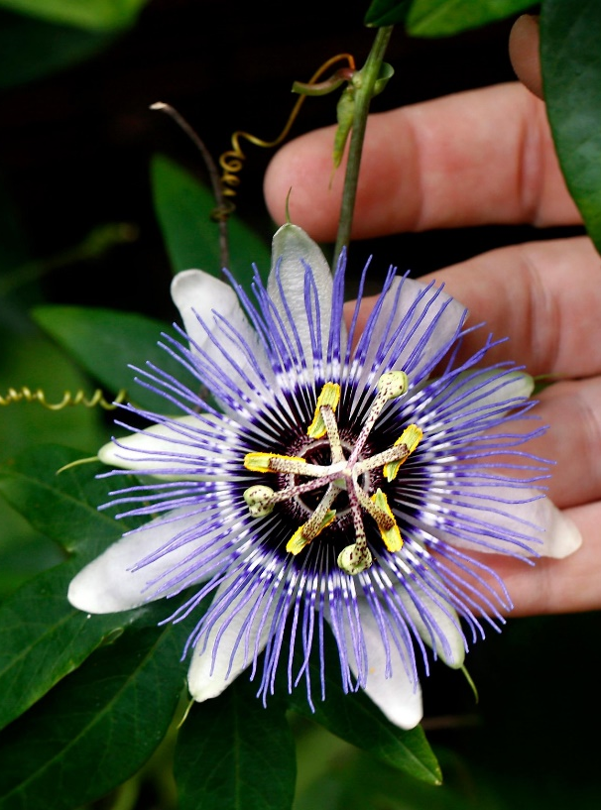
Psychedelic Harm Reduction and Integration in Current Clinical Practice
Psychedelic assisted therapy is illegal, though many are seeking it
32 million US lifetime users of psychedelics (Krebs & Johansen, 2013)
Can meet with clients before and after their personal psychedelic use
New clinical area
Unclear guidelines
Sensitive legal issues
Know your laws: in the US it is considered free speech to talk about psychedelics in session as long as you aren't recommending them
Very possible that psychedelics come up within your own practice
Poll
Krebs, T.S., & Johansen, P. (2013). Over 30 million psychedelic users in the United States. F1000 Research, 2:98, 1-5.
Notes:
Poll: Have you had a client bring up to you an interest or question related to psychedelics?

Slide 31
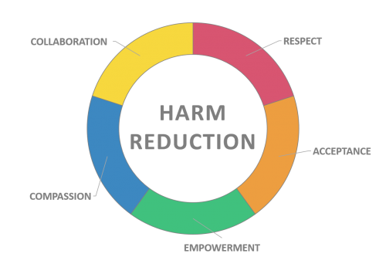
Preparation in Current Clinical Practice: Harm Reduction
Harm reduction approach: provides clinical utility in balance with operating within professional and ethical boundaries
Harm Reduction: set of practical strategies and interventions for reducing negative consequences associated with drug use
Social justice movement to promote respect for the rights of people who use drugs

Slide 32
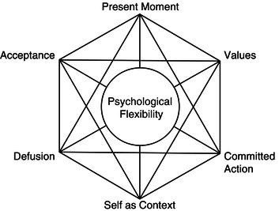
What ACT Tools can I Bring to Harm Reduction for Psychedelic Preparation?

Slide 33
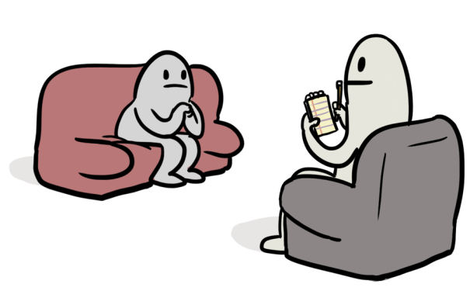
ACT-Based Harm Reduction in Psychotherapy for Psychedelics
Functional contextualism stance in therapy
Therapist does not have moral stance around substance use
Empower clients to make informed decisions
Client-centered around their beliefs, values, etc
Notes:
Don’t know whats best for client
Humanistic, take a humble approach

Slide 34
ACT-Based Harm Reduction in Psychotherapy for Psychedelics
Values
Clarifying reasons for seeking psychedelics
Values strategies → deeper conversation for reasons
Ex.- transitioning from not depressed into what is a valued life
Moves into intention setting: providing direction to be lightly held on to during dosing
Notes:
Don’t know whats best for client
Humanistic, take a humble approach

Slide 35
ACT-Based Harm Reduction in Psychotherapy for Psychedelics
Committed action
Accessing accurate information
Identify risks and benefits
Having clients do their own research as homework
Goals vs values- psychedelics may be just one way to achieve goal- what are others?
Pragmatism/workability
Creating helpful expectations
Notes:
Don’t know whats best for client
Humanistic, take a humble approach

Slide 36
ACT-Based Harm Reduction in Psychotherapy for Psychedelics
Contextualism
Set and setting
Safety planning
Drug kits
Emergency contacts
Psychedelics Involve preparation and integration
Having a guide or sitter
Naïve view: this is the drug and it’s effect
Contextual view: any event is effected by its context
wedding metaphor

Slide 37
ACT-Based Harm Reduction in Psychotherapy for Psychedelics: If planning to use psychedelics
Present-moment awareness
Building mindfulness skills
Meditation experience enhances psilocybin's benefits and reduces dysphoric components (Smigelski, et al, 2019)
Surrender to the experience
Acceptance, Flexibility
ACE Model: Accept Connect Embody (Watts & Luoma, 2020)
Accept: Let go, sense, feel
Being open to new insights
Smigielski, K., Kometer, M., Scheidegger, M., Krahenmann, R., Huber, T., & Vollenweider, F.X. (2019). Characterization and prediction of acute and sustained response to psychedelic psilocybin in a mindfulness group retreat. Scientific Reports, 9, 14914.
Watts, R.W., & Luoma, J.B. (2020). The use of the psychological flexibility model to support psychedelic assisted therapy. Journal of Contextual Behavioral Science, 15, 92-102.

Slide 38
Discussing Risk , Benefits, and Options With Clients

Slide 39
Discussing Risk with Clients
Potential Risks
Difficult or challenging experiences
Uncertainty of safety and purity of substances
Potential interactions with current medications or health
E.g. cardiovascular risk
Sudden or destabilizing changes in perspective
Difficulty explaining experiences to family and friends
Difficulty returning to daily life
Potential risk for triggering psychosis or mania

Slide 40
Discussing Risk with Clients
Does this person have sufficient distress tolerance and emotion regulation capabilities to experience and integrate a psychedelic experience?
Ex.- Exposure therapy for PTSD comparison
Do they have enough social support?

Slide 41
Options for Clients Who Want a Psychedelic Experience
Common Illegal routes
Self-use
Group, individual, friend as sitter
Underground guides

Slide 42
Options for Clients Who Want a Psychedelic Experience
Current legal options for clients
Ketamine (US)
High dose cannabis
Religious groups (e.g. Santo Daime)
Holotropic breathwork
Sensory deprivation tanks
Clinical trials
Psychedelic tourism (Netherlands, Jamaica, etc)
Retreats (yoga, meditation, etc)
Legal psychedelics (e.g. Salvia)
Light-induced (e.g. mind machine)
Other spiritual practices
rhythm-induced trances
fasting

Slide 43
Discussing Benefits with Clients: Write Down Your Answer
"I heard something about magic mushrooms being used in therapy. Why are psychedelics beneficial?"

Slide 44
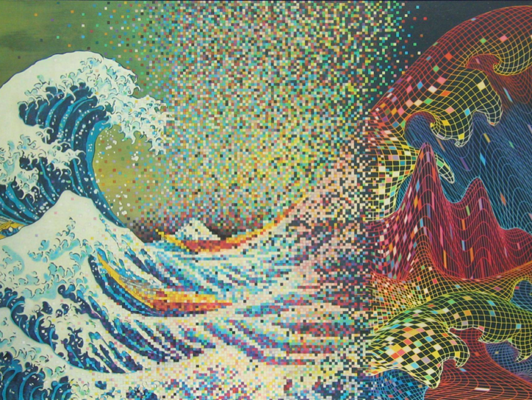
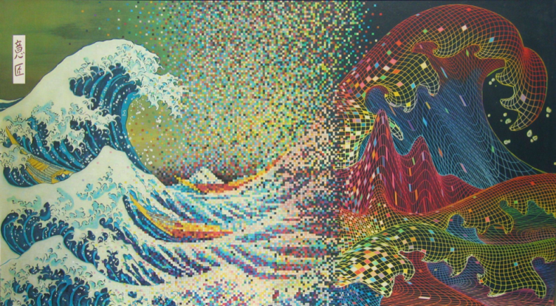
Discussing Benefits with Clients
Practice your own way of describing benefits
Tools for psychological growth
Helps us confront things we don't even know that we are avoiding
Clarifies what is important to us (values)
Point to outcome data from clinical trials
When used in a safe and supportive context, they can be beneficial for at least some psychological problems
MDMA seems to have this ability to heal from past trauma
"Recreational" use vs. therapeutic use (set and setting matter!)

Slide 45
Part 3: ACT-Based Integration Therapy for the Use of Psychedelics

Slide 46
Goals of Psychedelic Therapy
Flexibility (cognitive and emotional)
Cultivation of curiosity
Strengthen observing mind (self as context)
Ongoing experience of spaciousness of mind (cognitive defusion)
Compassion (self and others)
Improved interpersonal relationships; Love (self and other)
Flourishing/enhanced well being (valued living)
Restoration of dignity/self-respect/integrity
Meaning/purpose/new behaviors (committed action)
Increased creativity; improved problem-solving
Joyfulness/playfulness/sense of humor
Improved self-awareness, boundaries, self-care

Slide 47
But how does it work?
“Perhaps most important are a willingness to engage in a deep process and a commitment, and proper support to work to integrate the MDMA experiences. Unlike most psychiatric medicines, MDMA does not act by directly suppressing symptoms. It appears to work by catalyzing a psychotherapeutic process that can be challenging along the way and can be problematic without commitment and support to work through and integrate the challenges.” – Michael Mithoefer, MD

Slide 48
What is Integration?
An ongoing creative process of assimilating the mind, body, and spirit after an entheogenic experience for the purpose of maximizing the benefits with a focus on wellbeing and growth; deriving meaning from your experience and applying insights gained into your life.

Slide 49
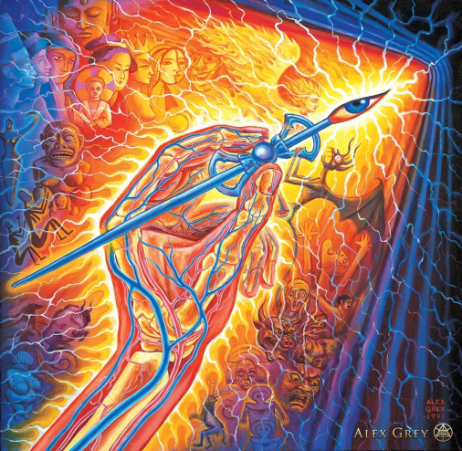
Psychedelic Integration
Having a profound psychedelic experience does not automatically translate into long- term changes
Integration is an individualized process that is very different for each person. Process continues to unfold over days, weeks, months
Trust the ongoing/unfolding process; it is not limited to the time in which you are "in the medicine."
Minimize over-verbalizing or ascribing meaning to the experience; stay open; thinking vs being (cognitive defusion); continue to cultivate curiosity.
Multidisciplinary approach; explore nonverbal processing (spirituality, exercise, art, music, body work, acupuncture, sound healing, breathwork, reiki, qi gong, etc)
Notes:
Focus on daily self-care practices that may include reconnecting with the experience of being "in the medicine" or dropping back into expansiveness

Slide 50
Major Goals of Integration
Durability: Accrual of benefit and consolidation of gains
Safety/stabilization: Smooth re-entry, prevention, ongoing monitoring
Attachment: Relationship repair
Enhanced self-monitoring: Observing mind, self as context, neutral stance
Debriefing: Emotional processing, meaning-making, releasing, grieving
Resolving: negative beliefs and conflicts among parts of the self
Application of new found wisdom; behavior change; committed action
Understanding challenging experiences; from avoidance to acceptance

Slide 51
Integration Challenges
Rapid Relapse
Zig-zagging
The Therapeutic Bends
“Dropping the Ball” / Insufficient Follow-up
Spiritual Bypass
Flight into Health
Unearthing Unanticipated Feelings and Memories

Slide 52
R A P I D R E L A P S E
Copyright ©️ 2020 Polaris Insight Center. All rights reserved.

Slide 53
Zig-zagging
Most healing has a nonlinear, inconsistent, oscillating path
Expectations can lead to hope and then disappointment

Slide 54
The Therapeutic Bends
A period of disequilibrium and difficulty in adjusting to rapid recovery
Acknowledges that even positive change can be stressful or have unintended consequences
Can manifest as overwhelm and distress
Loss of “sick role” identity or habituated sense of self

Slide 55
“Dropping the Ball” / Insufficient Follow-up

Slide 56
SPIRITUAL BYPASS
The use / misuse of spiritual philosophy & practices to avoid doing the work of processing through emotional conflict, pain & self-doubt.

Slide 57
FLIGHT INTO HEALTH

Slide 58
Unanticipated Feelings & Memories
Recovery can unearth unanticipated feelings and memories
Thawing, coming out of numbness
Navigating new emotional range
Finally able to address trauma, can trigger fight/flight/freeze/collapse
Anger, grief, shame, guilt, confusion

Slide 59
Setbacks, detours & zigzags all have
HEALING POTENTIAL
when navigated with creativity, mutuality & wisdom
Setbacks, detours & zigzags all have
HEALING POTENTIAL
when navigated with creativity, mutuality & wisdom

Slide 60
Express & Explore
TOGETHER
The power of human
RELATIONSHIP

Slide 61
DEPATHOLOGIZE
relapse, regressions & oscillations
Healing follows
a wiggly path

Slide 63
Client Wisdom
Honestly, I was scared during the most intense part of the journey. It was like a handshake with death. I was so confused to learn that all of what I thought as certain was a temporary narrative, a version of reality that had been slowed down to suit my body’s current bandwidth. I had disappeared; my name, my gender, all of the labels that construct who I am were stripped down and pulled away until I was gone, flowing through a constantly changing form that seemed like some sort of a city that never stopped changing. I was completely alone and with everything. All of these concepts that I’d heard about were felt.
Upon reflection, you had mentioned almost every aspect of what happened beforehand. You had cognitively prepared me for what I experienced - planting seeds, as you said - that became mental placeholders for what was to come. It was so intense.

Slide 64
Client Wisdom
“I am looking at myself with tender understanding and compassion, what a relief! I realize how hard I have been on myself…. there is no need to constantly beat myself up. I would never treat anyone else this way, It makes me sad, I treat myself the way my father treated me. I have taken it on and I am ready to let that go. Even though therapists have pointed this out in the past I am seeing this clearly for the first time.”

Slide 65
Break-Out Rooms
What concerns or issues do you have in talking with clients about psychedelics?
What biases do you have about psychedelics or "drugs"?
What challenges do you foresee in your practice ? (e.g. legality, perception of colleagues, etc)
What barriers exist for you in having these conversations with clients?
What are next steps for you such as further training or education?

Slide 66
Part 4: Questions and Discussion

Slide 67
Additional Training
Fluence
Psychedelics 101 & 102 two-day workshop
California Institute of Integral Studies
Certificate in Psychedelic-Assisted Therapies and Research
MAPS
MDMA Training Program
Polaris Insight Center
https://www.polarisinsight.com/for-clinicians/
Consciousness Medicine online course
Psychedelic conferences
PSS, Horizons
Media
Books, podcasts, documentaries
Local psychedelic society
Portland Psychedelic Society

Slide 68
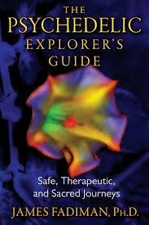
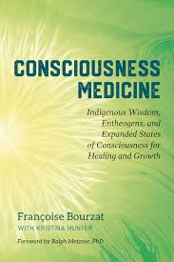
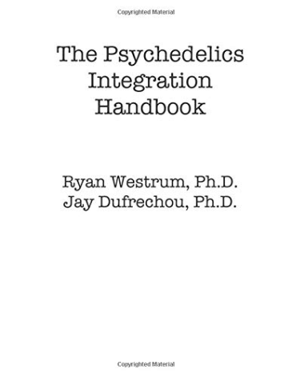
Resources
Erowid.org
Maps.org
Drugscience.org.uk
Dancesafe.org
Tripsafe.org
TheThirdWave.co
Psychedelictimes.com
Psychedelicstoday.com
Psychedelicreview.com
Consciousness Medicine by Francoise Bourzat
The Psychedelics Integration Handbooy by Ryan Westrum, Ph.D.
The Psychedelics Explorer's Guide by James Fadiman,Ph.D.

